Slide 1


Welcome to our 2025-2026 Back to School Meet and Greet
Max S. Hayes High School

Slide 2
Important Contacts
Principal, Derek Patterson
(216) 838-9404
Assistant Principal, Margaret Robinson
Assistant Principal, Jeanine King
Campus Coordinator, Donna D’Amico
SAY YES Family Support Specialist, Bobby Jordan

Slide 3
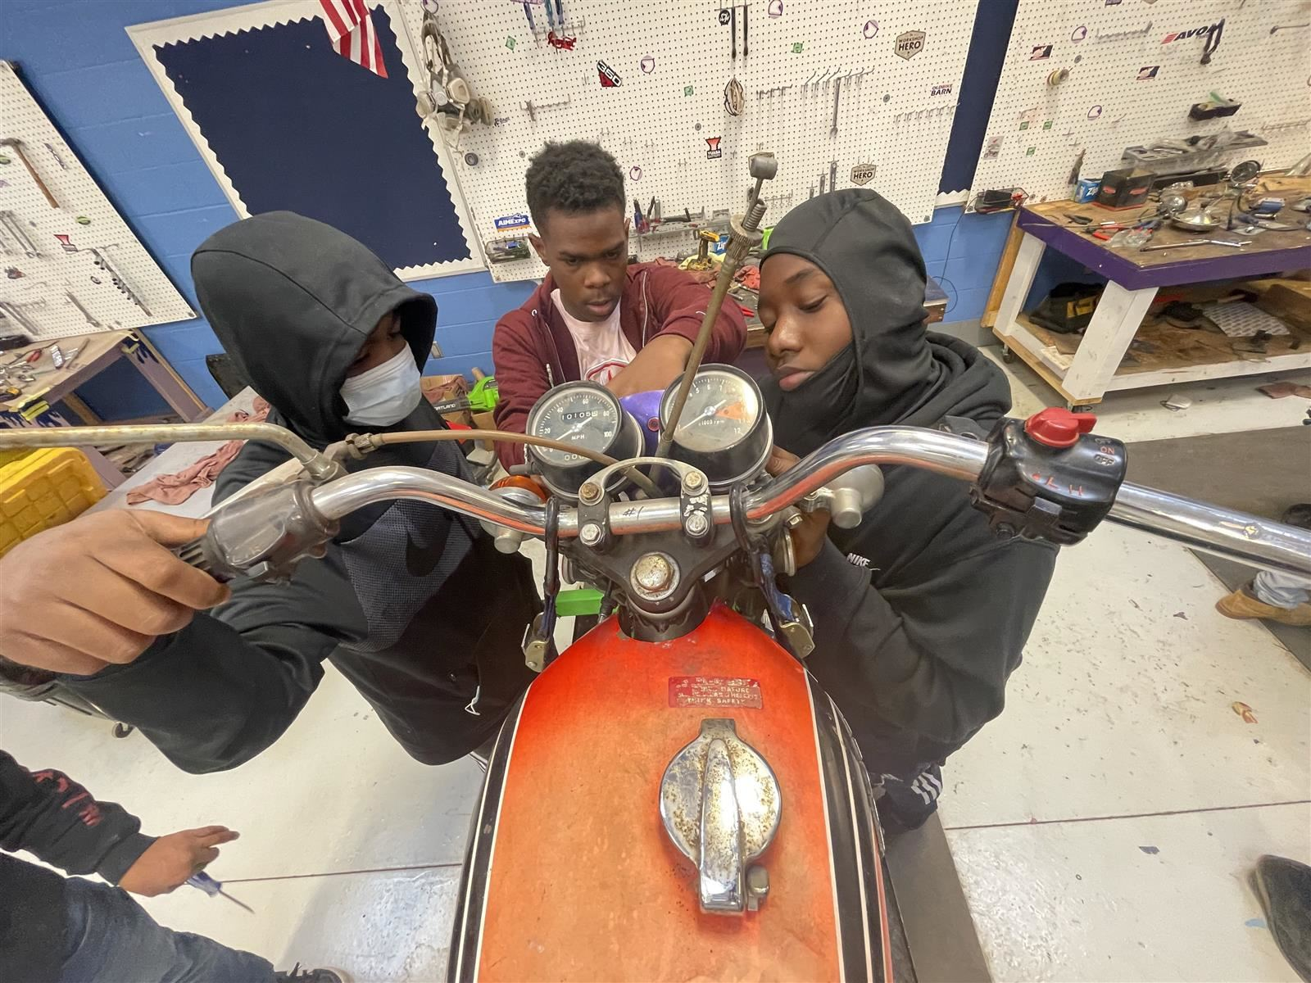
At Max S. Hayes High School, we prepare students to become future skilled labor professionals. We prepare students not only with technical skills but also with the mindset, professionalism, and work ethic expected in today’s workforce. By aligning classroom experiences with real-world industry standards, we ensure that every lesson, project, and collaboration mirrors the expectations of future employers—empowering students to transition confidently from the classroom to their careers
and well-being of our s

Slide 4
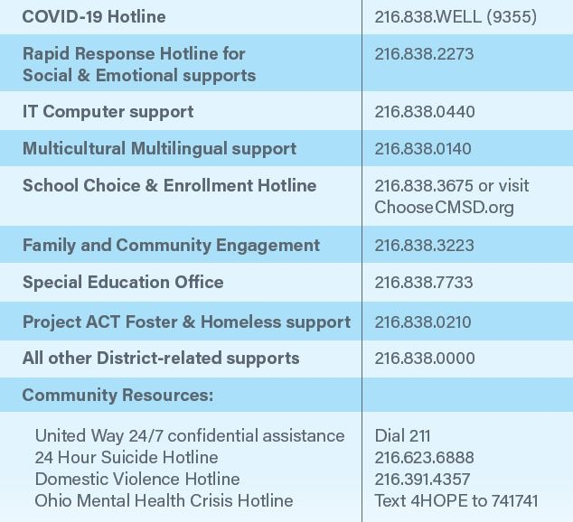
Other Important Numbers

Slide 5

School Office Hours and Visitation Procedures
School Office Hours: 8:05 a.m. – 3:30 p.m.
School Building Hours: 7:45 a.m. – 5:45 p.m.
Please call to make an appointment prior to visit if possible.
Secretary, Ingrid Khadige (216) 838-9402

Slide 6
School Information (cont’d)
Breakfast 8:05 a.m. – 8:30 a.m.
Class Start Time 8:35 a.m.
Dismissal 3:05 p.m.
Lunch Guidelines/Policies – No outside food or deliveries allowed during lunch or school hours.
Attire/Dress Code
Laptop/Tech Devices fully charged every day!!!!!
Keep login and locker information confidential
Technology Distribution will occur on the following dates:
Tuesday, August 19th
Wednesday, August 20th
Thursday, August 21st

Slide 7
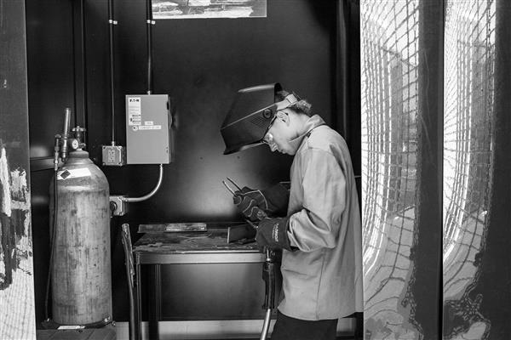
Academic & Learning Management System Information
Graduation Requirements
CTE Programming | Certification | Credentials
Schoology & Parent PowerHub Accounts

Slide 8
Schoology – Online Learning Platform
Schoology is an integrated learning management solution which provides course management, mobile learning, and support for communication.
Schoology enables our scholars, parents and teachers to engage with learning materials and their school community from the classroom and beyond.
With Schoology, scholars can digitally submit homework assignments, review grades, participate in interactive discussions, receive announcements and feedback, take tests, write academic blogs, and more.
As a parent, you will be able to view your child’s activity and progress within the platform and communicate with teachers.

Slide 9
Important Dates
School Starts – Monday, August 18th
Labor Day – Monday, September 1st (No School)
Annual Car Show – Saturday, September 20th
Open House – Wednesday, September 10th 6:00 – 8:00 p.m.
School Website
https://www.clevelandmetroschools.org/MAXSHAYES

Slide 10
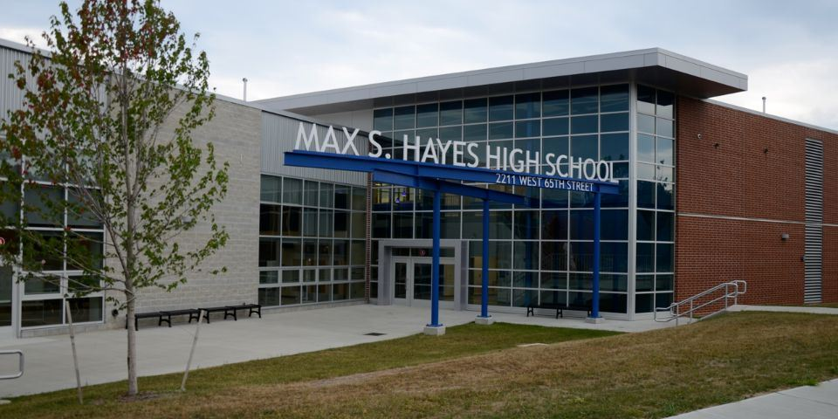
Title 1 Family and Community Engagement Budget for the 2025-2026 School Year!
$4,000.00

